Slide 2
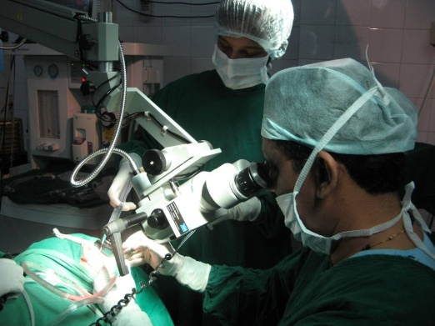
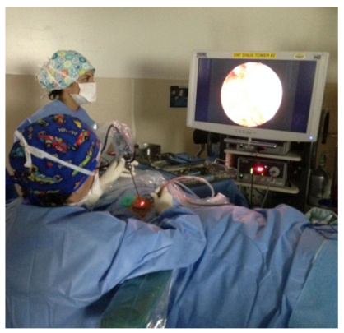
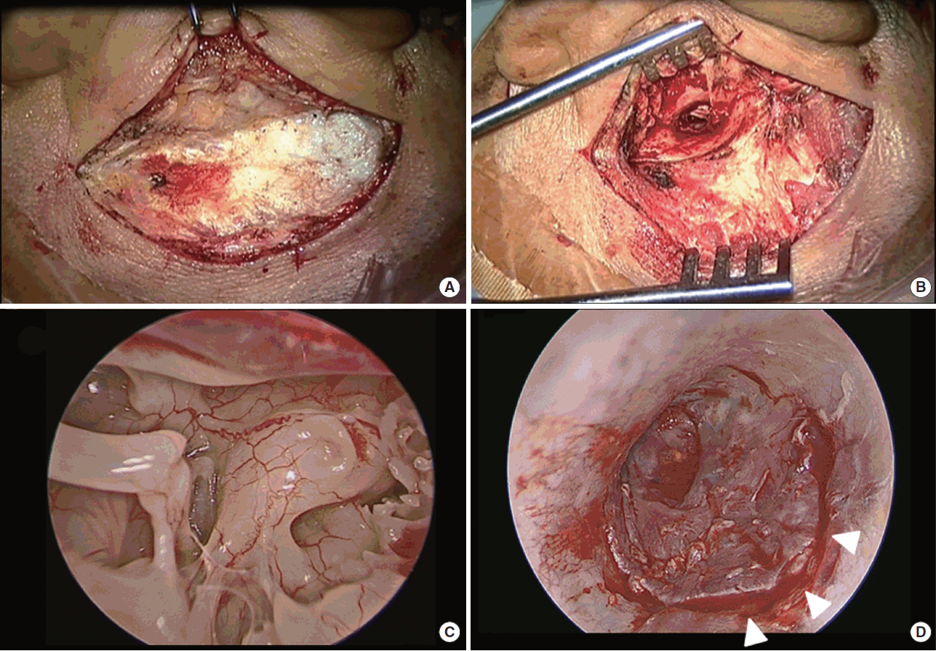
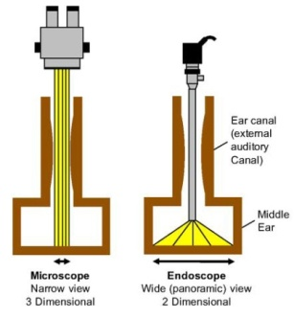
A
B
C
D

Slide 3
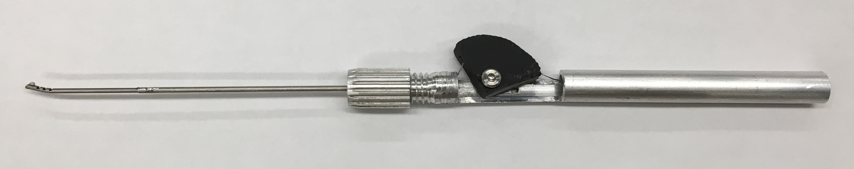
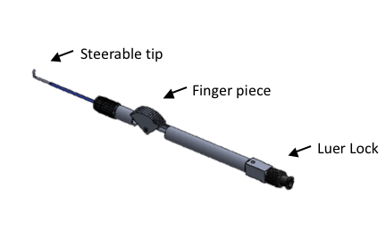
finger piece
wrist
stainless steel shaft
collet clamp
cable
handle
This shows the prototype with the wrist, notches milled into a nitinol tube, connected to a stainless steel shaft that is clamped onto the handle that consists of a finger piece that controls the cable displacement of the cable attached to the nitinol wrist. Moving the finger piece back causes cable displacement and thus wrist actuation.

Slide 4
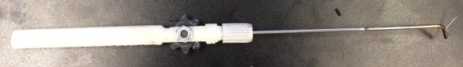
Pen-style handle prototype
The pen-style prototype requires the surgeon to grip the instrument similar to how they grip current tools during middle ear surgery, like a pen. This prototype is the basis of the next generations of the prototype. The handle design was conceived by developing a way to pull on the cable actuating the wrist while encased inside an instrument handle of similar size to current instruments. To tug on the cable, a slider or a wheel would be simple to actuate and the wheel took up less space and less movement of the fingers so that was decided.

Slide 5
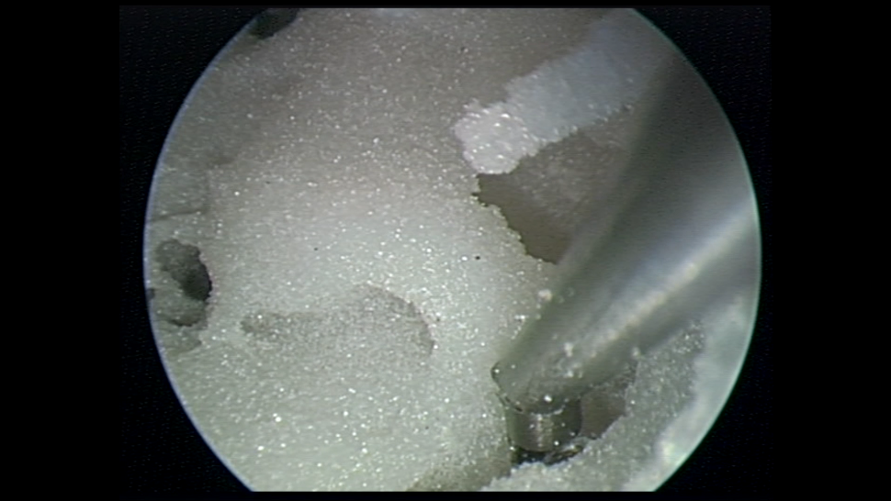
Promontory
Sinus Tympani
This is a model of the left temporal bone. The promontory is a landmark bone inside the middle ear, behind the ossicles. The sinus tympani is shown and is very difficult to reach into with standard, rigid tools to dissect and remove cholesteatoma. Often, the cholesteatoma is visualized in the sinus tympani with the endoscope but the tools cannot reach inside to extract it. This image shows, with an endoscope view, that the controllable, flexible instrument can reach into the sinus tympani.

Slide 6
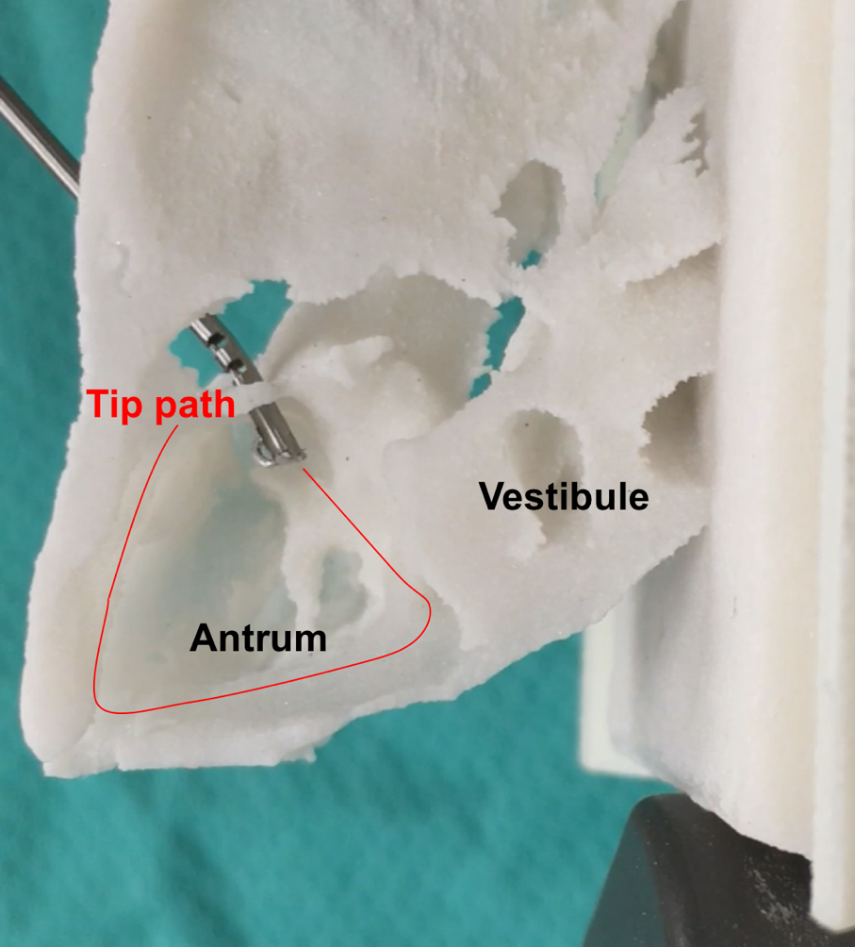
This is a model of the left temporal bone. The model has been cropped so that the antrum is visible in this bird’s eye view. Cholesteatoma had eroded the ear canal in this patient like an atticoantrostomy, a hole in the ear canal where the instrument is coming through. Thus, the instrument is introduced through that opening and the tip can reach and dissect the boundary of the antrum.
Ear Canal

Slide 7
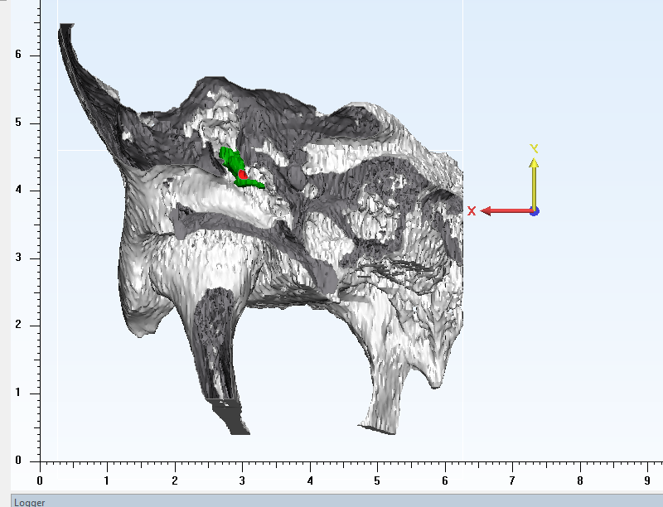
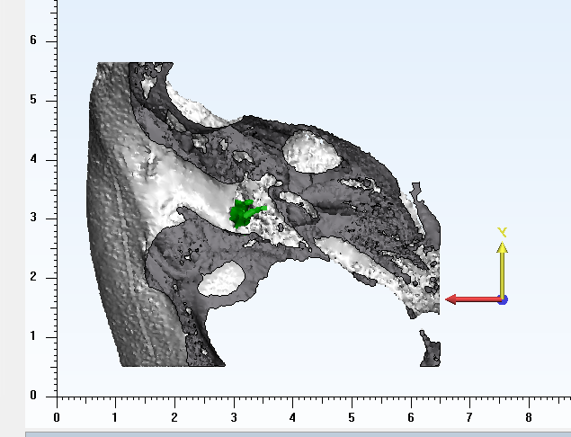
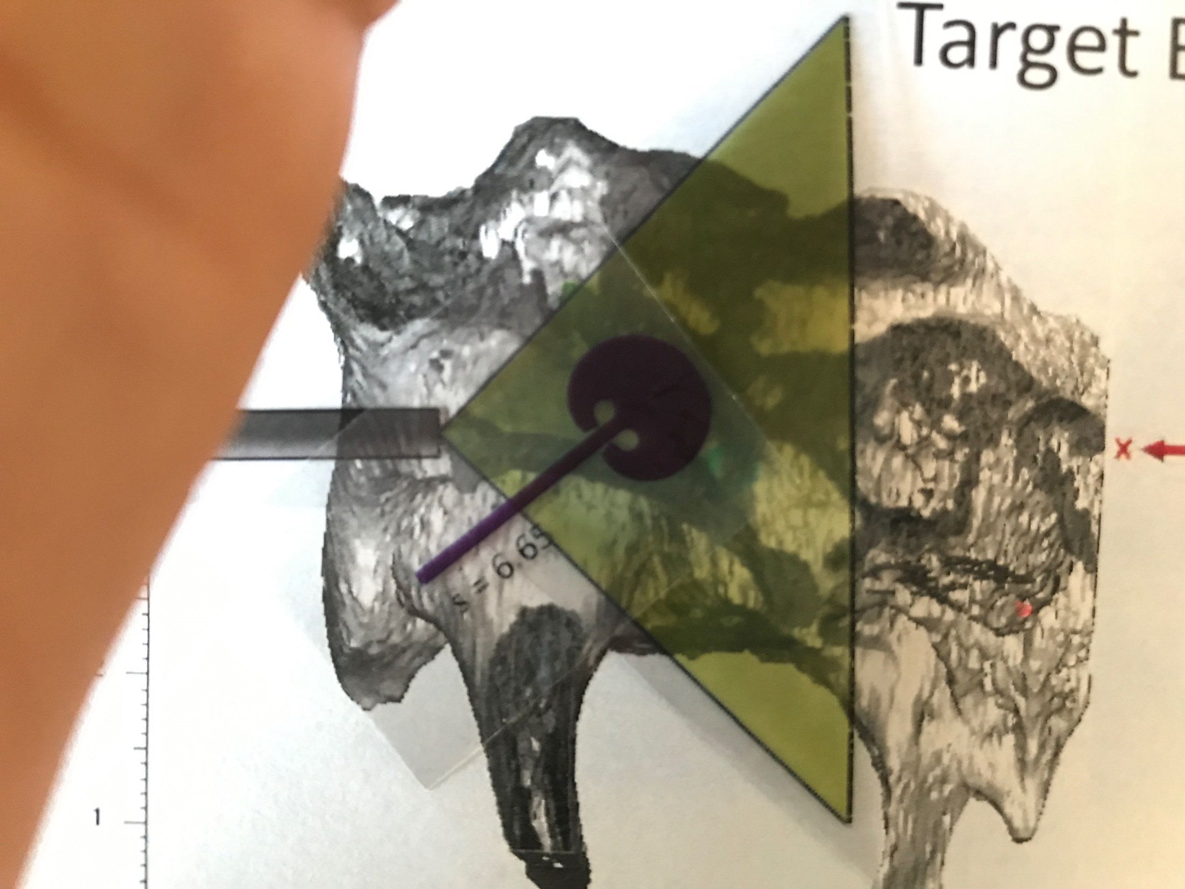
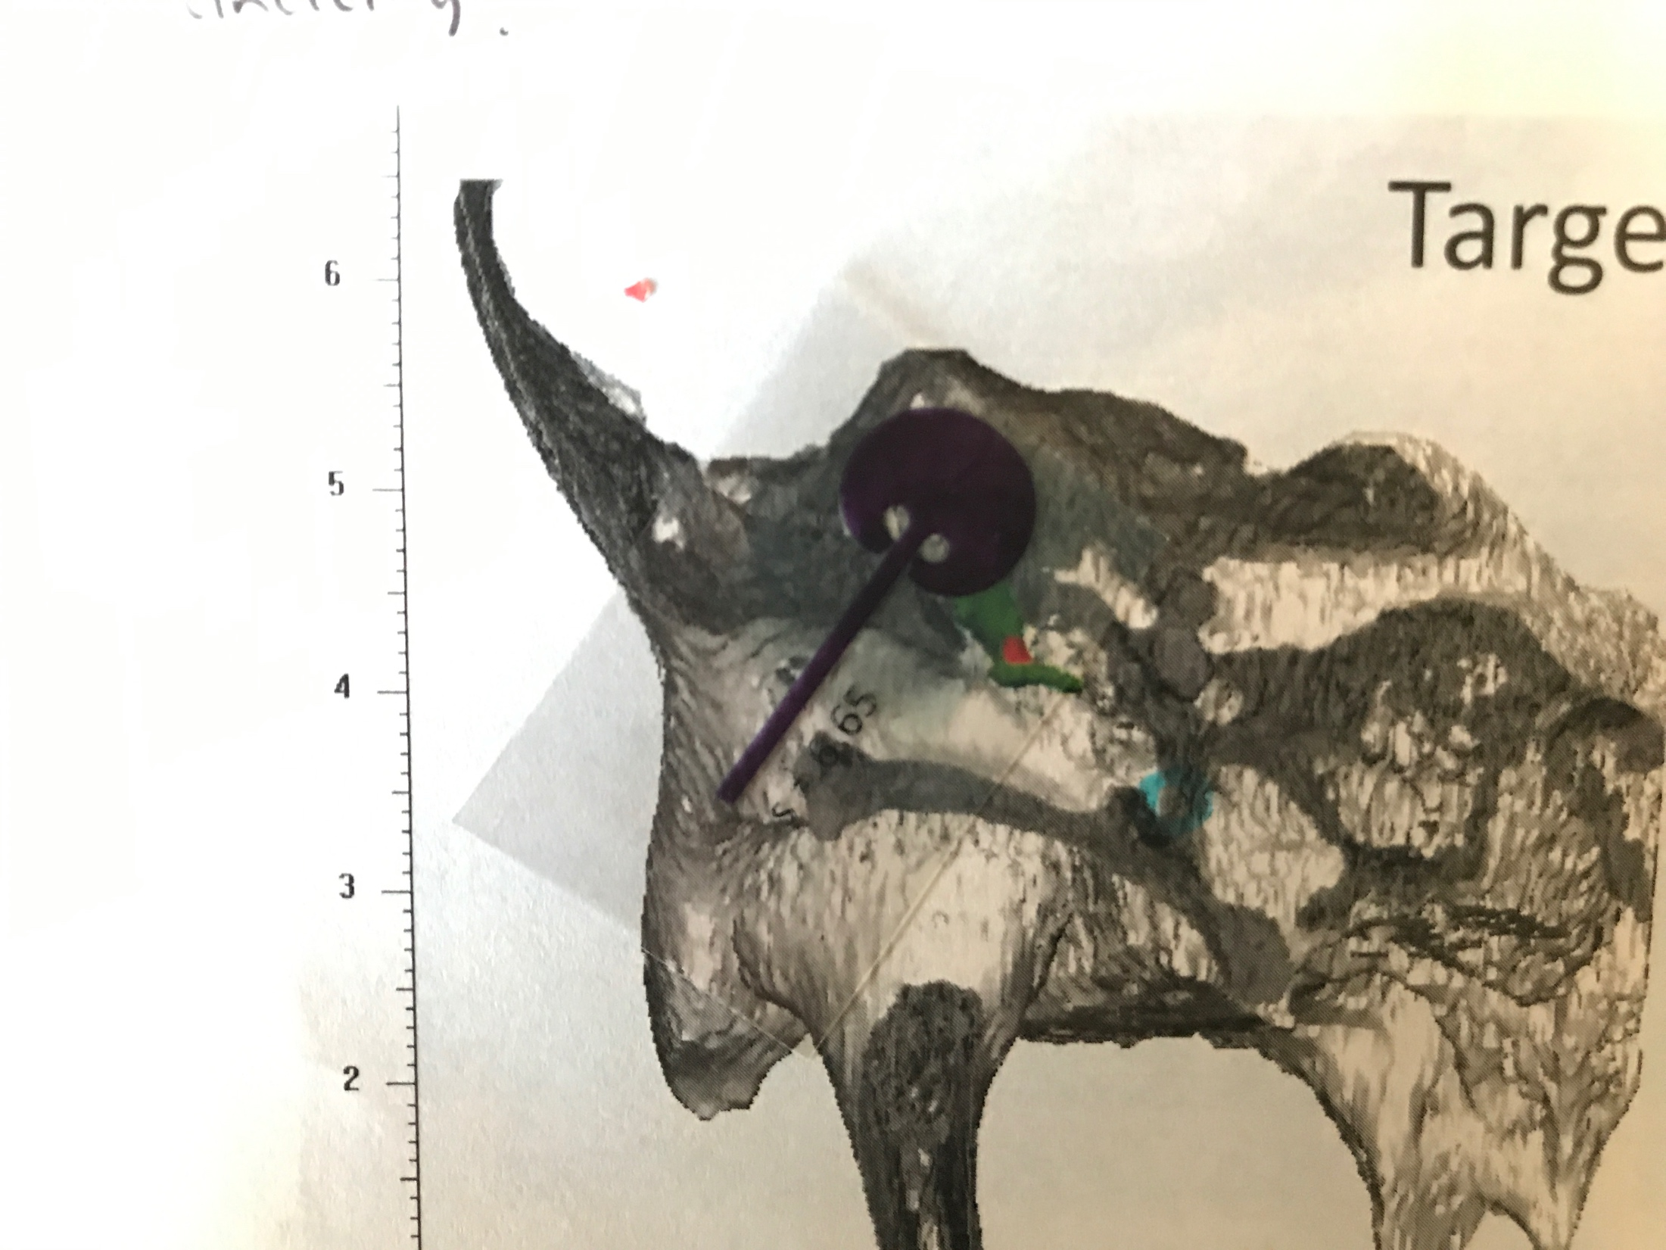
Antrum
Endoscope viewing range
Ossicles
Sinus tympani
Ear
Canal
Ear
Canal
Ossicles
Instrument total reach area
3D virtual model of temporal bone anatomy used to identify structures for the new tool to reach.

Slide 8
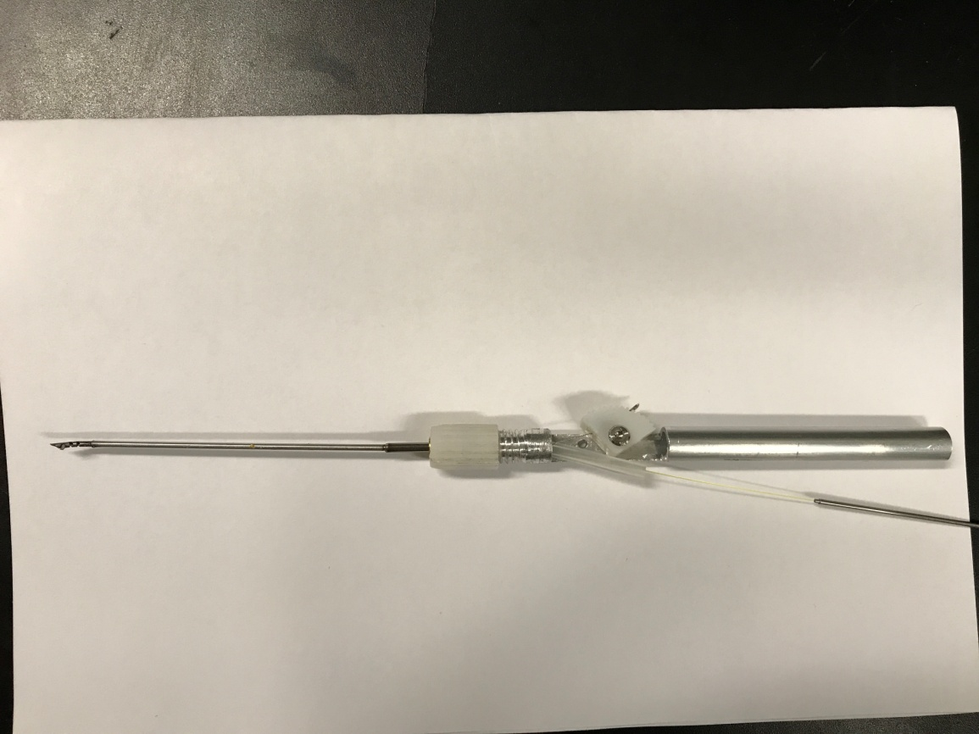
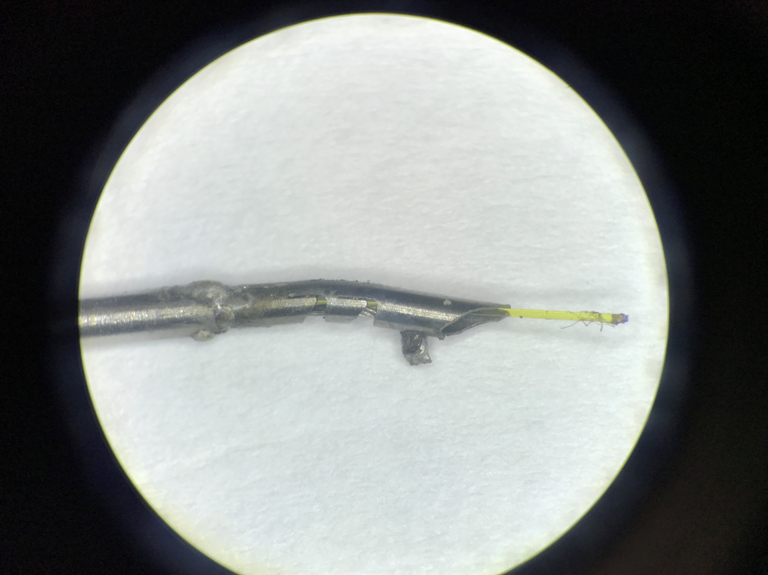
Finger Piece
Collet Assembly
Handle
Shaft
Wrist
Laser Fibre
Laser Fibre
Cable

Slide 9
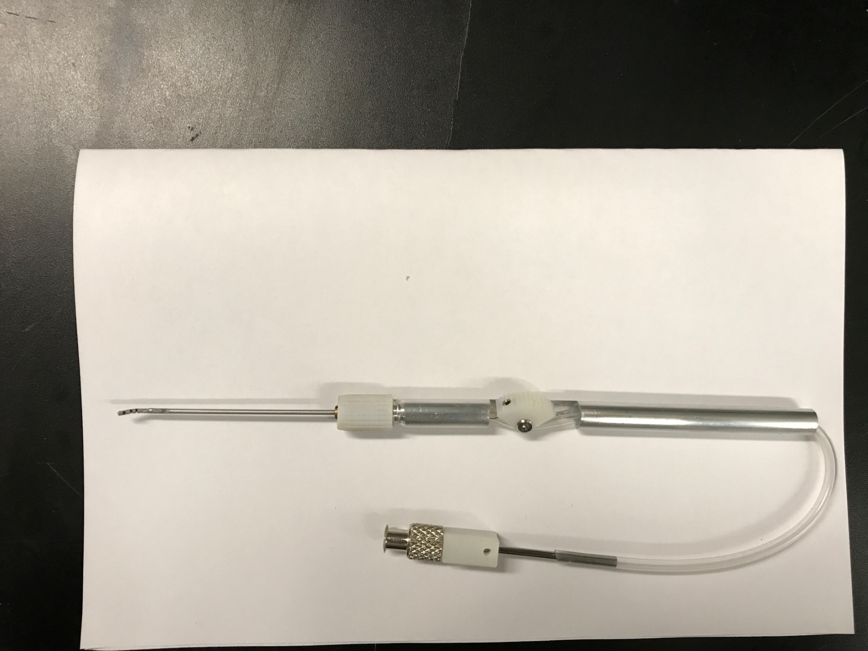
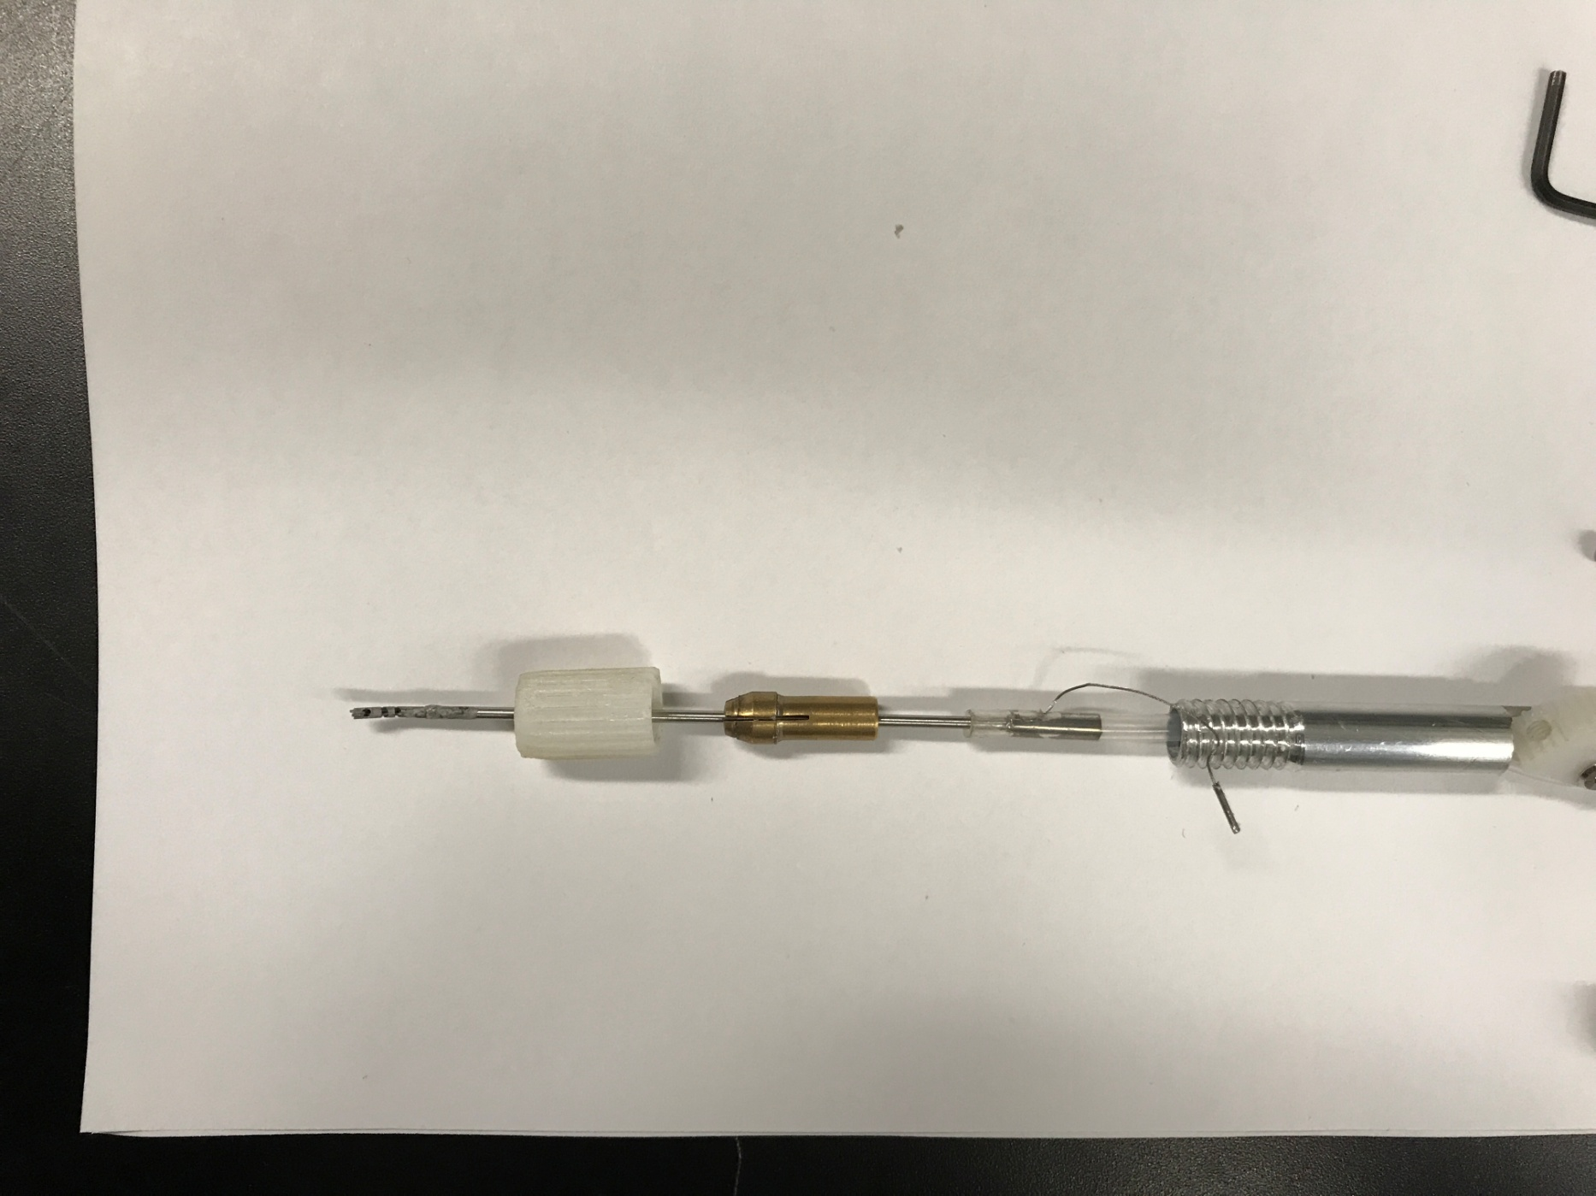
Wrist
Finger Piece
Handle
Shaft
Luer Lock
Connector
Tubing
Collet Assembly
Collet Clamp
Cable
Collet
Tubing
Adaptor Tube

Slide 10
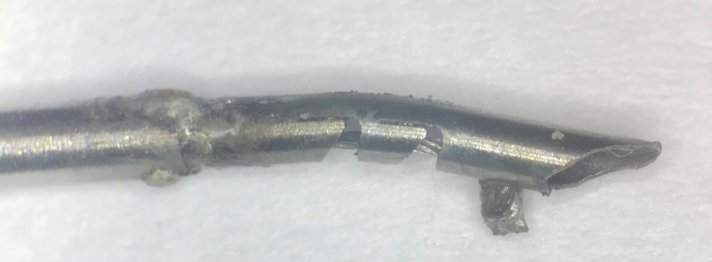
Controller: Finger Piece
Handle
Flexible Tip
Luer Lock for suction
Connector
Tubing for suction or laser fibre
Flexible Tip

Slide 11
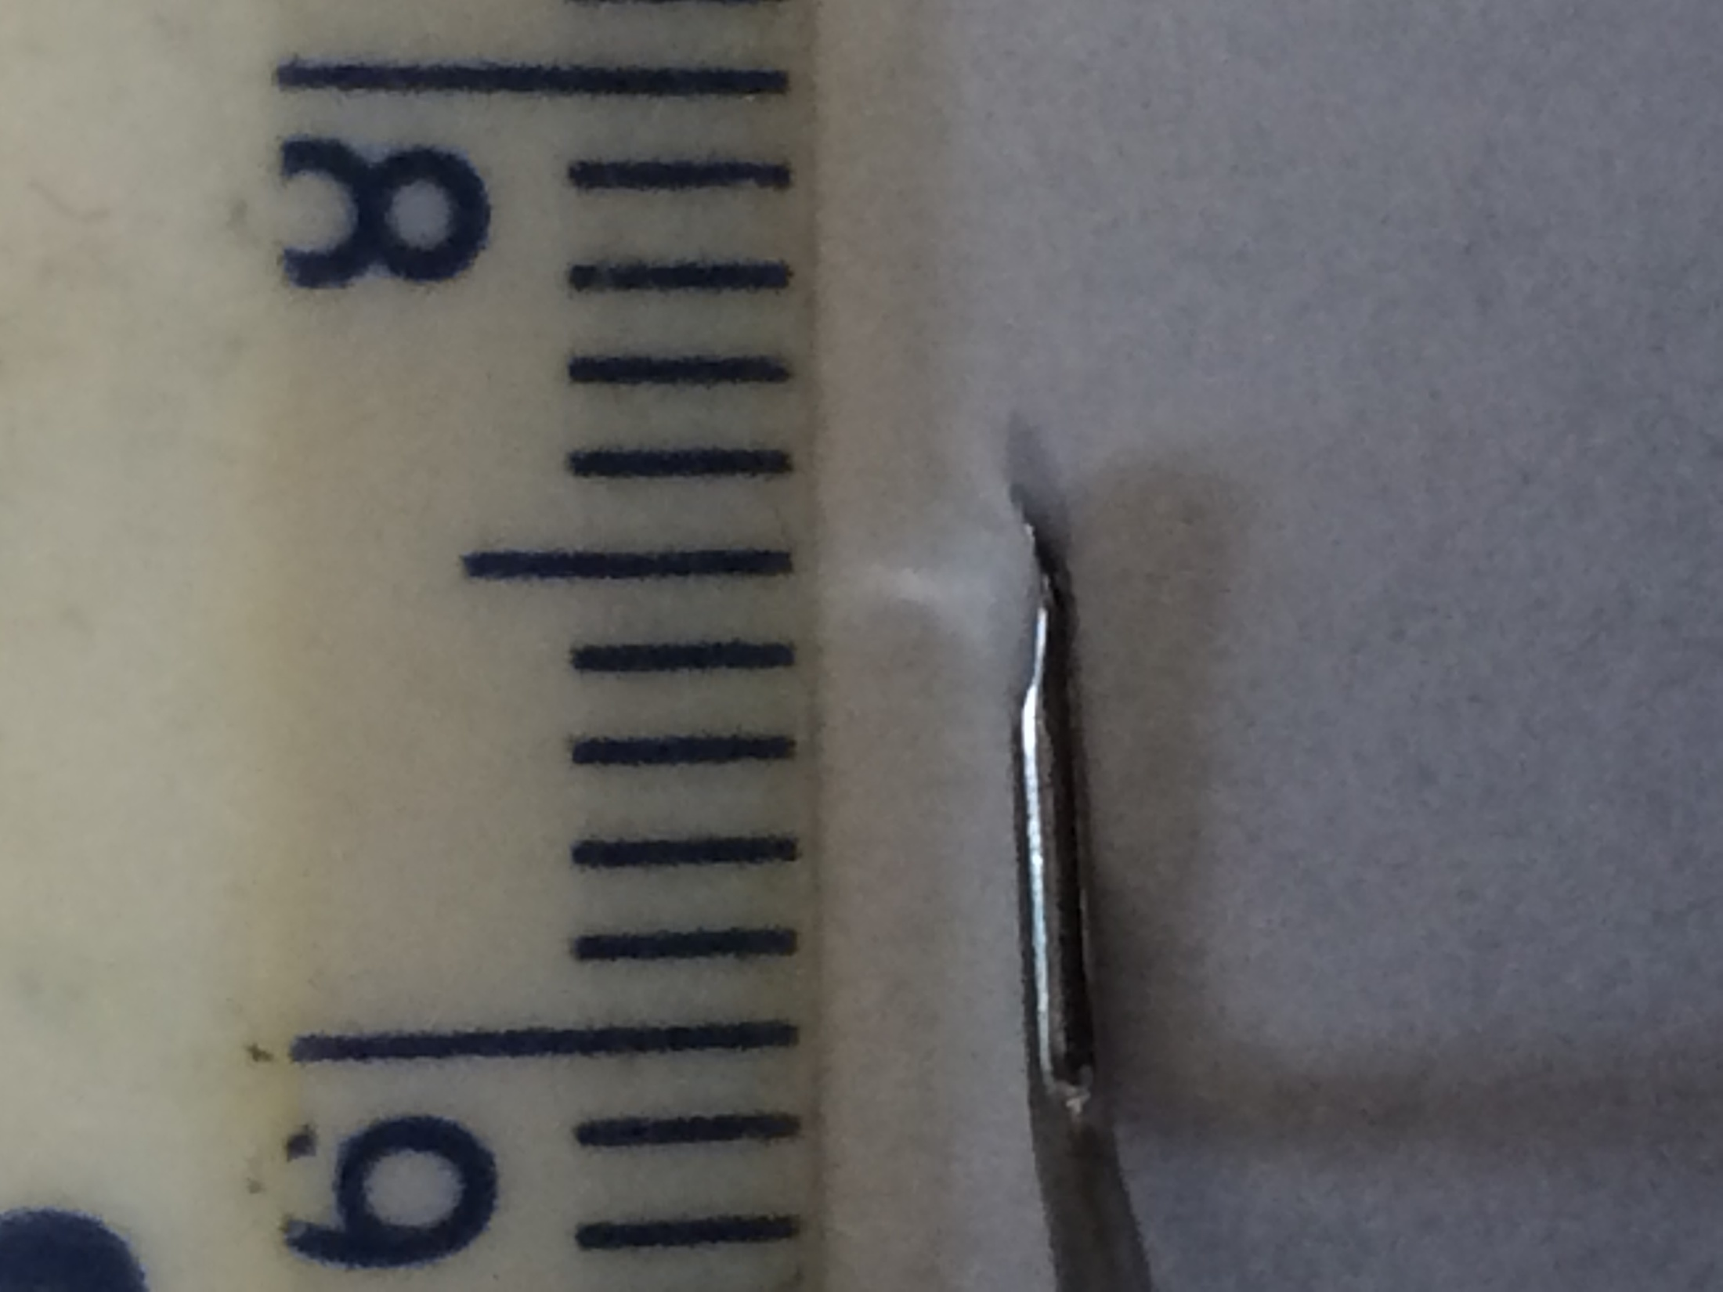
Proposed Tool Dissector Tip
Thomassin Dissector Tip

Slide 12
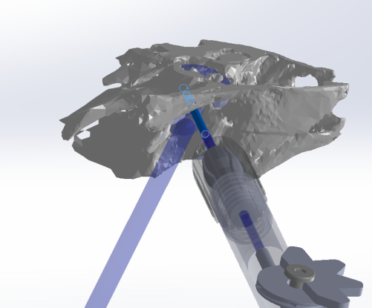
Temporal Bone Model
TEES Instrument Prototype
Ear canal
Endoscope

Slide 13
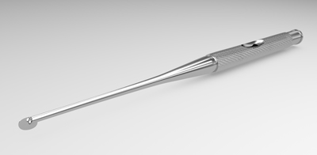
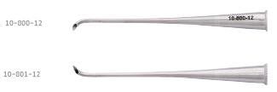
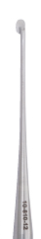
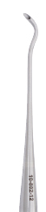
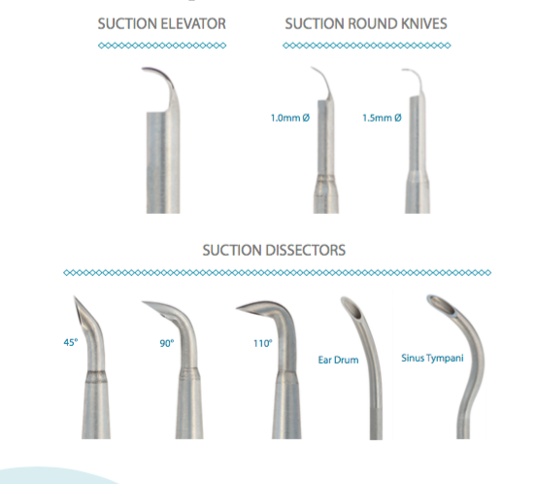

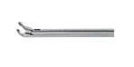
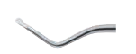
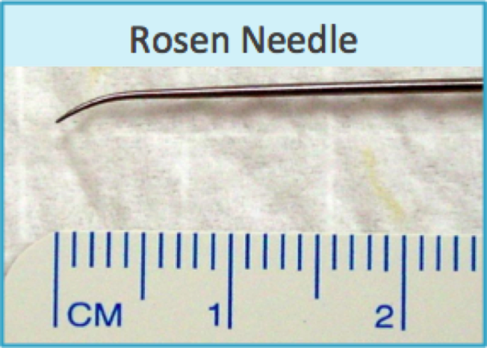
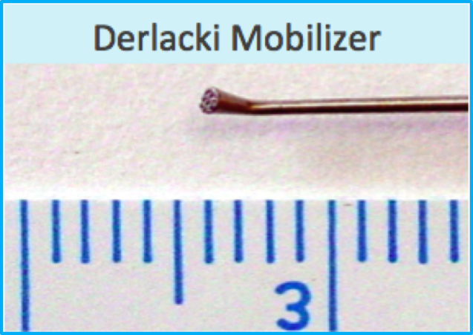
Spiggle & Theis Panetti Endoscopic/Microscopic Instrument Set for Middle Ear Surgery
Suction Knife, Oval
Suction dissectors
Grace Medical IWGEES Instruments
Karl Storz Middle Instrument Set for Endoscopic Middle Ear Surgery
Derlacki Mobilizer
Rosen Needle
Thomassin Dissector
Forceps
These are different sets of endoscopic ear surgery instruments. The Spiggle & Theis Panetti set incorporates suction along the shaft of its instruments in order to allow for two functionalities, suction and dissecting or suction and cutting, in one tool, eliminating the need to switch between a suction instrument and dissection instrument or knife. Grace Medical and Karl Storz have similar suction capabilities but the PI has preferred the curves of the Panetti set. Many instruments have a curve at the tip in order to reach the middle of the endoscopic field of view, which does not occur for straight-shaft instruments as the ear canal constricts the movement of instruments. The Thomassin dissector, Derlacki Mobilizer and Rosen Needle are frequently used by the PI to position grafts and dissect tissue as their respective tip shapes are preferred to manipulate tissue effectively. The Rosen Needle tip curvature allows for dissecting tissue that is attached to the ear drum as the tip shape compliments the curvature of the ear drum, and when the needle is rotated axially, the tip follows a trajectory which is useful to manipulate tissue without having to translate the tool which would cause the instrument shaft to collide with the endoscope or ear canal wall. Other companies such as Bausch and Lomb, Medtronic and Sklar also have endoscopic ear surgery instruments.
http://www.sklarcorp.com/instrument-sets/plastic-surgery/sinus-endoscopy-set.html

Slide 14
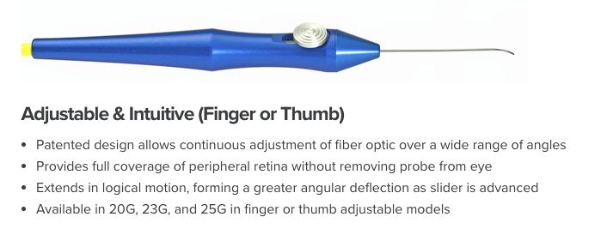
Steerable Instruments
Vitreoretinal laser probes
Surgical Instrument
Here are two examples of current instruments that are steerable. The vitreoretinal laser probes are used to deliver laser energy to the retina for therapy. The slider at the handle allows the surgeon to push out the preshaped 90º nitinol tip. The surgical instrument is a manually engageable handle + steerable tip with pin joints.
http://salientmed.com/solution/endoprobe-handpieces/
https://patents.google.com/patent/US7766904B2/en?q=endoprobe&q=adjustable&q=flexible https://www.google.com/patents/US5454827

Slide 15
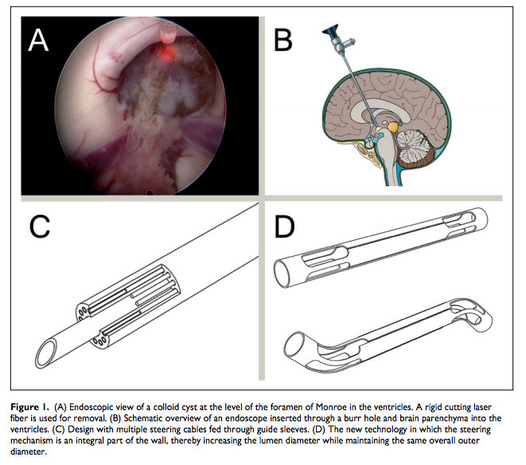
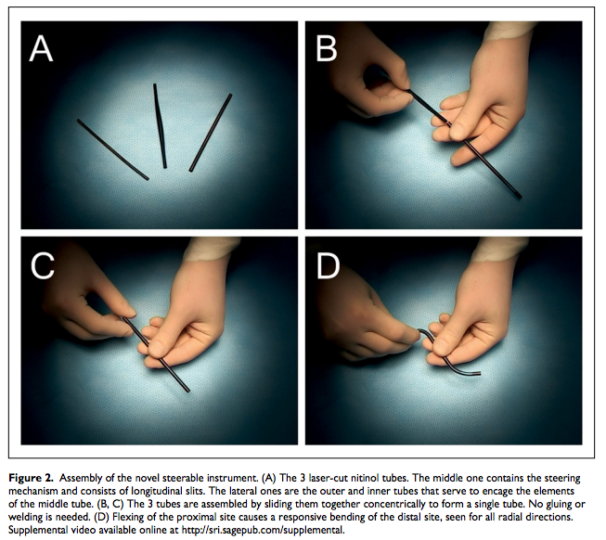
Dewaele et al. describes an instrument that consists of a nitinol tube that has been laser-cut in a pattern that enables a surgeon to steer the tip (distal end) by flexing the other end that is held in their hand (proximal end). The controllable flexible instrument presented here also has a nitinol tube tip that is laser cut. However, it is steered by pulling on a cable, rather than bending the proximal end.

Slide 16
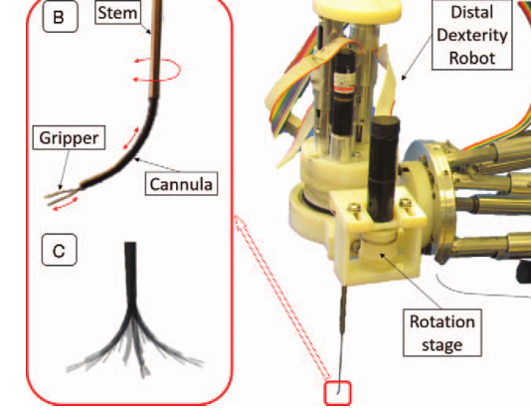
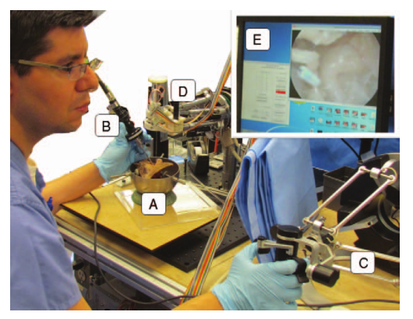
This shows an overview of the steerable robot-assisted micromanipulation device for the middle ear. The left panel shows the robot with the tool extending downward out of it, and the right panel shows the surgeon teleoperating by gripping the ‘distal dexterity robot’. The gripper consists of forceps, attached to the cannula which is a nitinol tube which is shape set to a permanent radius of curvature of 7.5mm. The cannula can retract into the stem where the instrument assumes a straight position. As the cannula extends out of the stem, the tip assumes a curved shape.

Slide 17
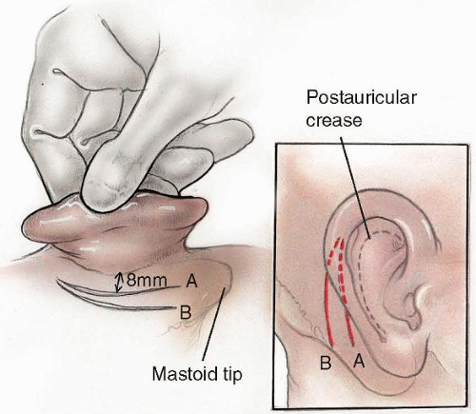
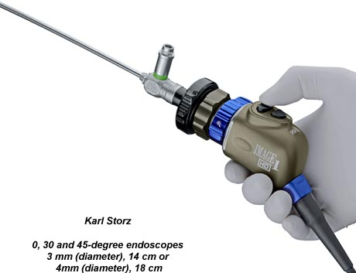
1
3
A
B
2
C
D

Slide 18
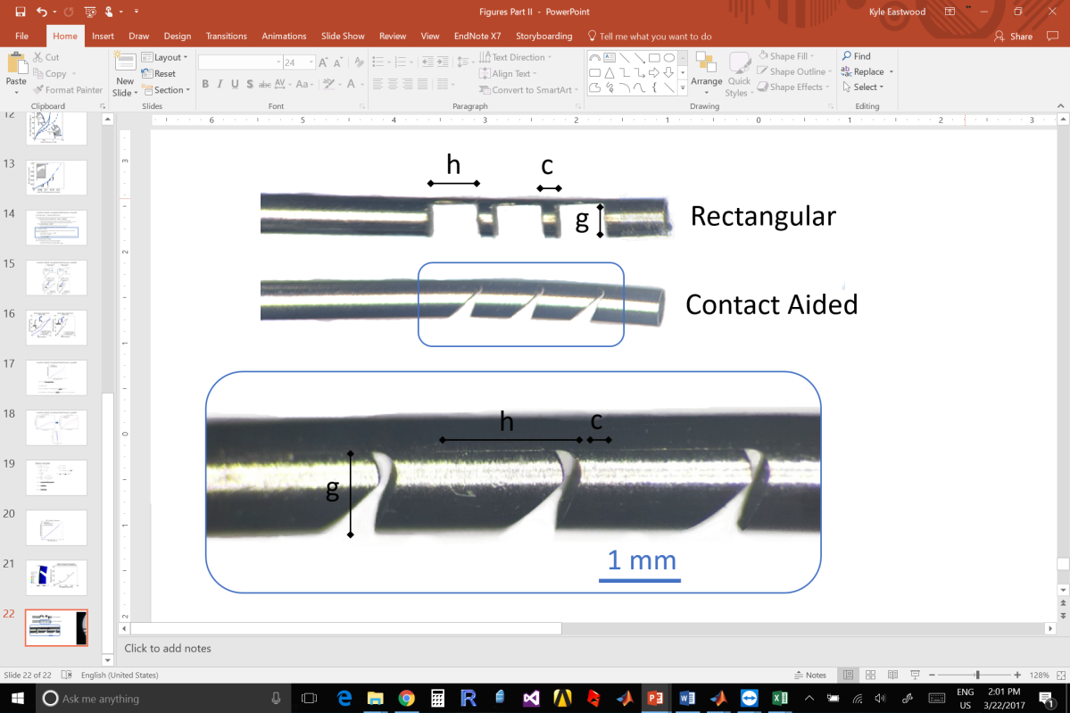
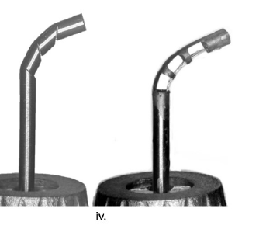
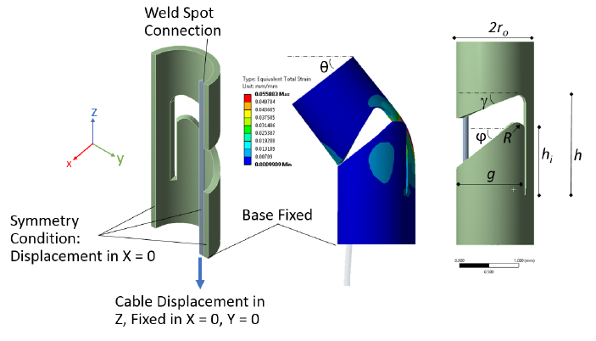
Rectangular Notch Wrist
Contact-Aided Compliant Mechanism Wrist
Eastwood et al. describes the two wrists that are presented in this report. The top panel shows the simple, rectangular notched wrist geometry. This is the geometry used for manufacturing prototype 1. The bottom panel shows the contact-aided compliant notched tube, which was laser cut into a nitinol tube to manufacture prototype 2.

Slide 19
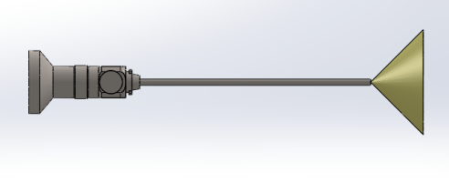
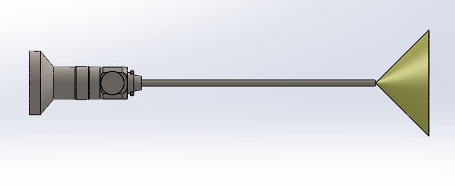
135º
Ossicles
45º
Ear Canal
Ear Drum

Slide 20
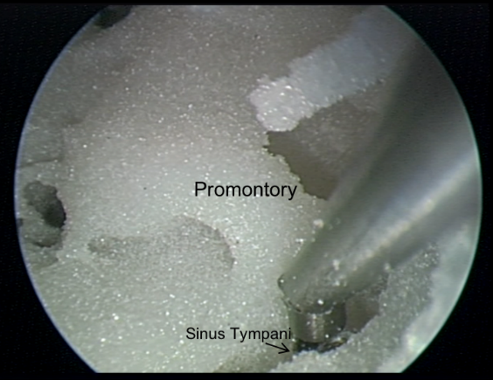
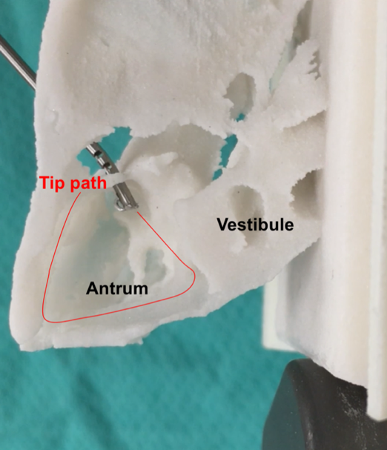
Ear Canal

Slide 21
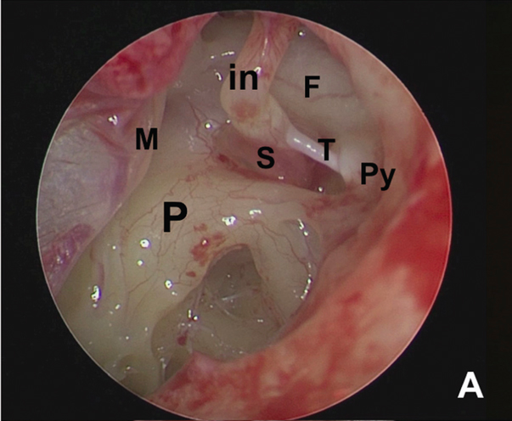
M, in, S are the hearing bones (ossicles) malleus, incus, stapes, respectively. F is the facial nerve, P is the promontory, Py is the pyramid, and T is the stapedial tendon.
http://ejo.eg.net/viewimage.asp?img=EgyptJOtolaryngol_2017_33_2_477_206014_f2.jpg

Slide 22
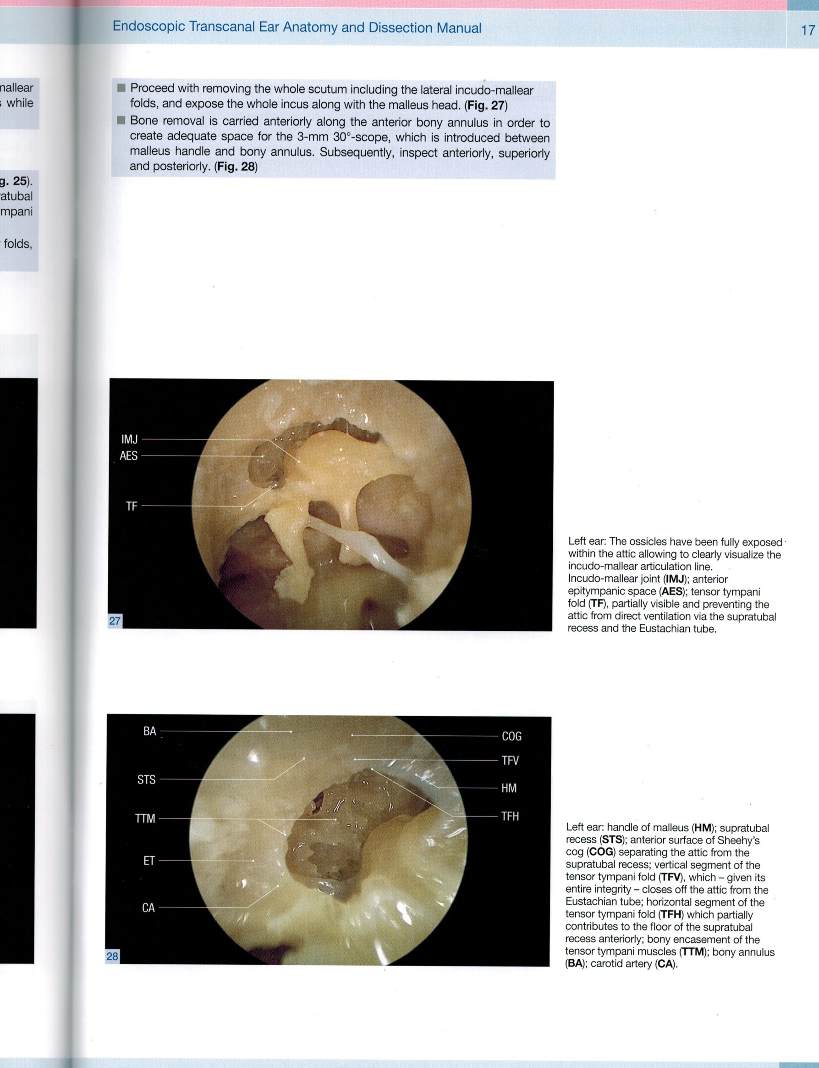
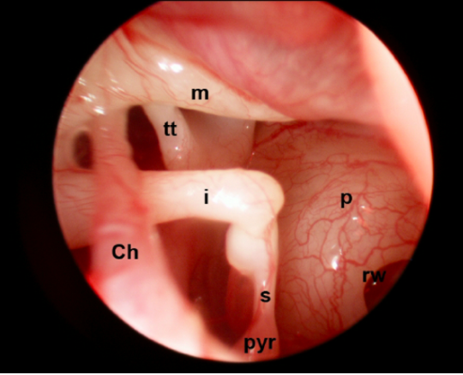
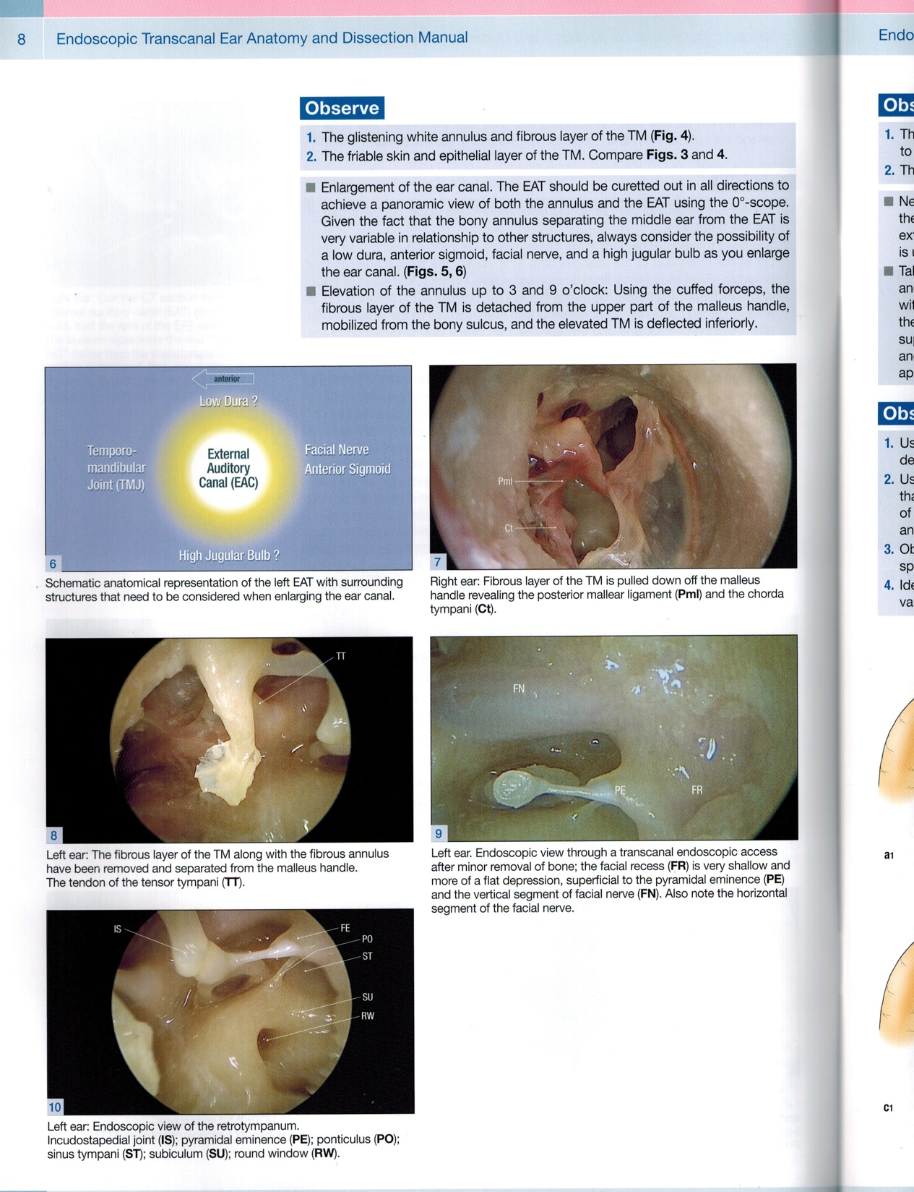
AES
Ossicles
ST
RW
These are endoscopic images through the ear canal during a dissection of the middle ear. I, incus; m, malleus; s, stapes (the ossicles); p, promontory; ch, chorda tympani; rw, round window niche; AES, anterior epitympanic space; ST, sinus tympani; NF, facial nerve, CSL, lateral semi-circular canal and entry into the mastoid antrum; AM, entry to the mastoid antrum.
Page 8, 17, https://www.researchgate.net/figure/291206710_fig1_Fig-1-Endoscopic-view-of-the-right-ear-posterior-tympanic-cavity-using-a-27-mm-30
http://www.arquivosdeorl.org.br/conteudo/acervo_eng.asp?Id=653

